Slide 1
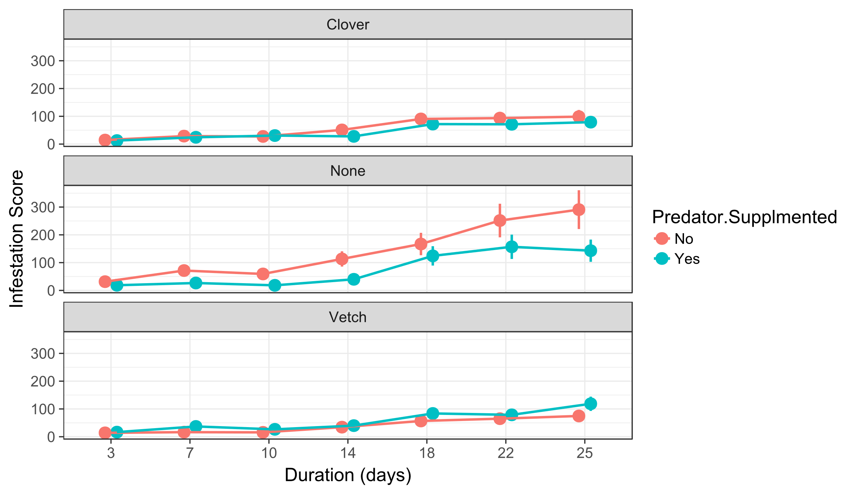
Predator effects on infestation were only significant in control dorms

Slide 2
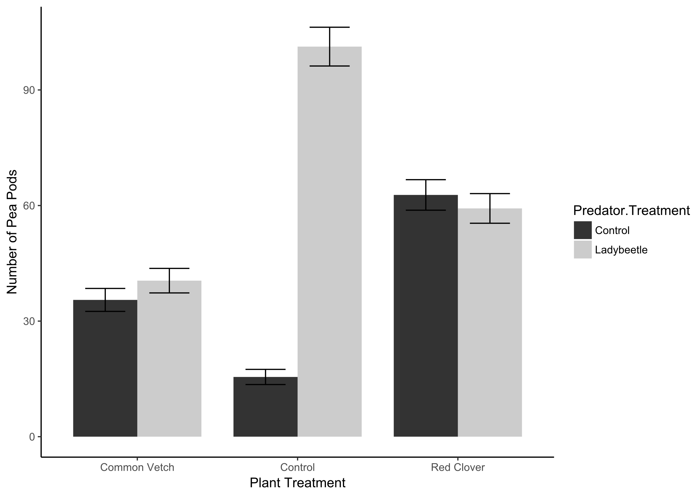
Ladybugs increased yield in control dorms, but not vetch or clover dorms

